Slide 1
Project Management
Pub Quiz

Slide 2
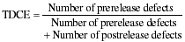
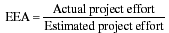
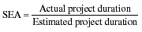
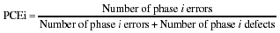
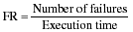
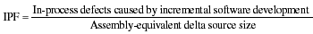
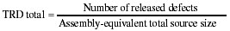
Who am I? Project Management terminology

Slide 3
Vocabulary
The following are ________ associated with high performance teams.
confidentiality
acceptable be in time crunch or trouble, but unacceptable to surprise others
zero tolerance for bulling a way through a problem or issue
agree to disagree, but support decisions once made and move forward
respect outsiders
hard work does not get in the way of having fun

Slide 4
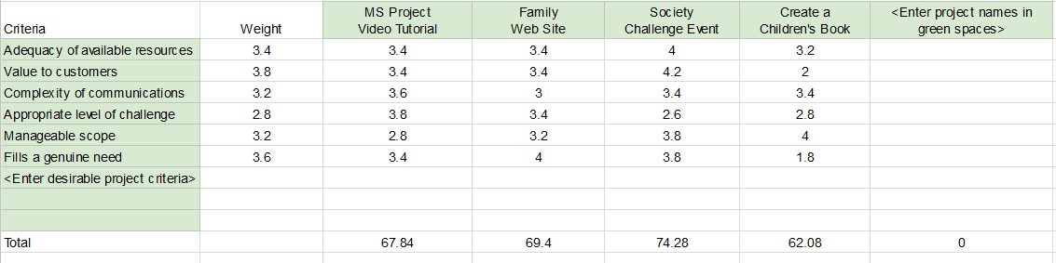
Who am I?

Slide 5
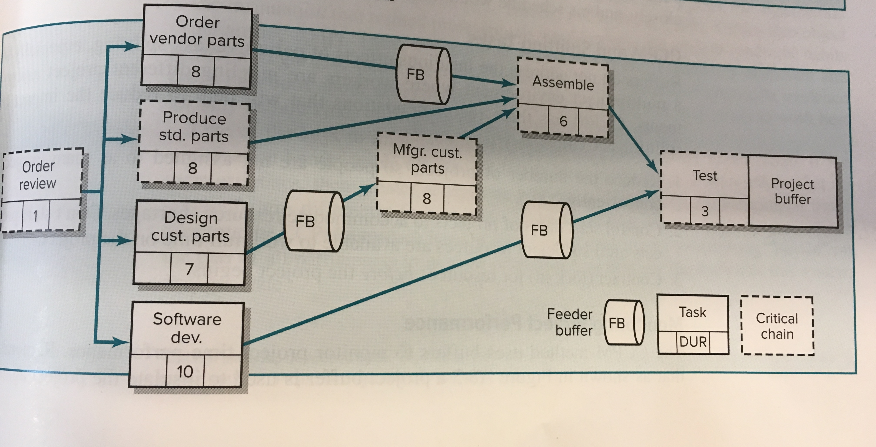
Name that method

Slide 6
Management Skills
The following are elements of establishing a ____________:
Effective use of meetings
Co-location of team members
Creation of a project team name
Get the team to build or do something together early on (quick wins)
Team rituals

Slide 7
Who am I?

Slide 8
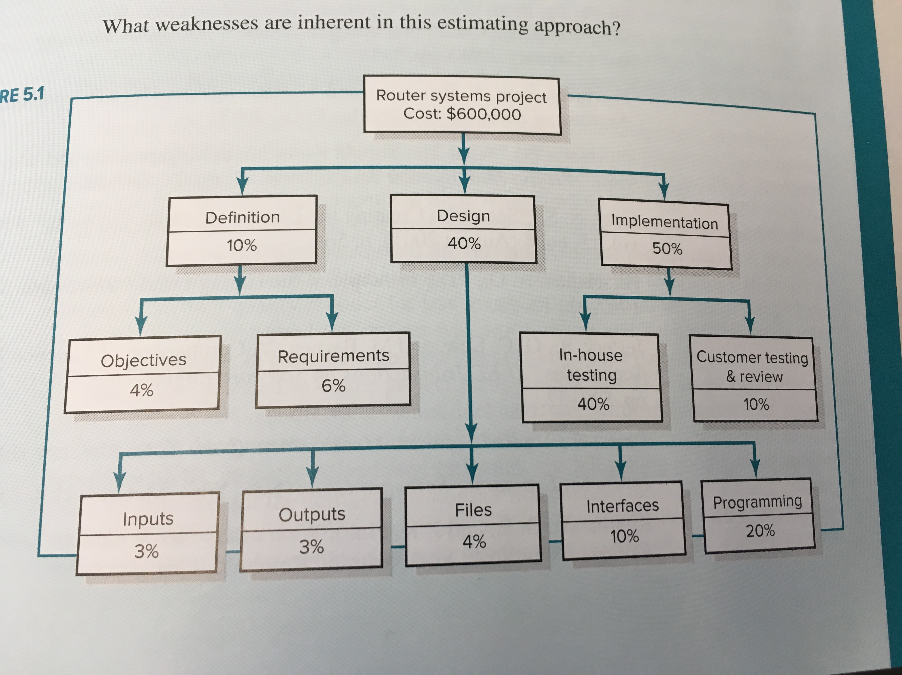
Who am I?

Slide 9
Calculate
What are the estimated costs for Design and Outputs?

Slide 10
Vocabulary
What does the term “white elephant” refer to in projects?

Slide 11
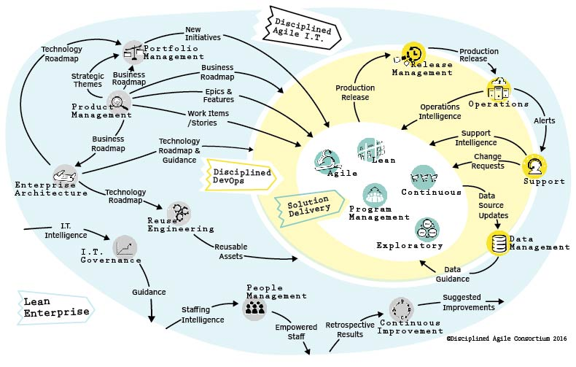
Name that method

Slide 12
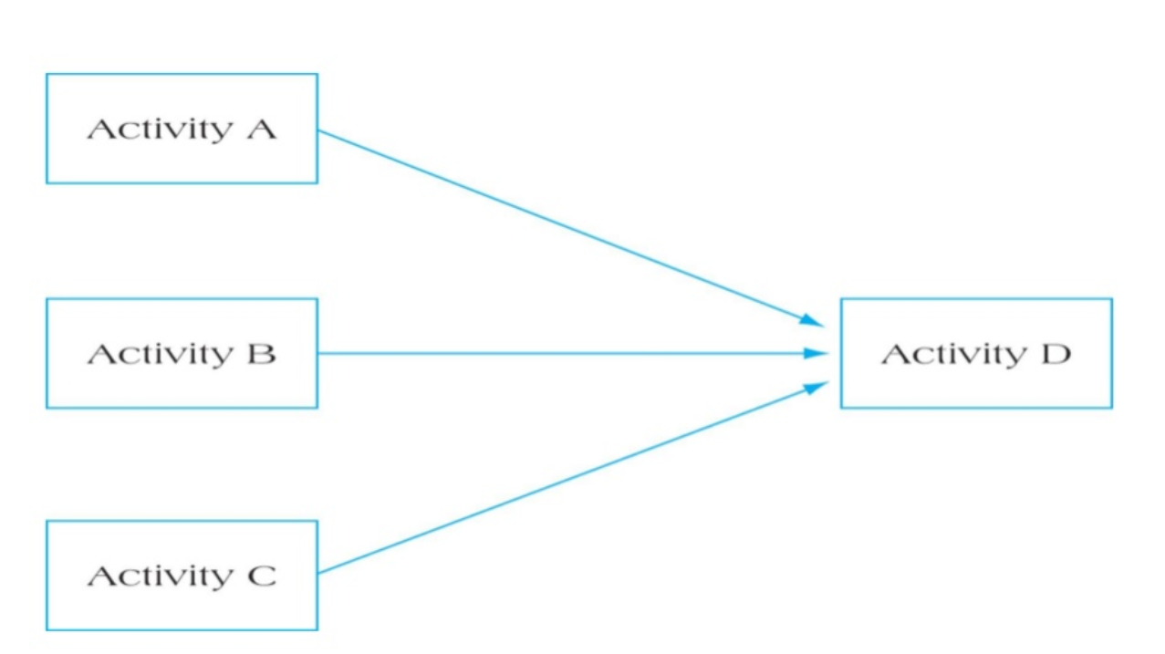
Who am I?

Slide 13
Management Skills
The following characteristics are considerations for what managerial activity and knowledge area?
problem solving ability
availability
subject matter expertise
credibility
political network/connections
amibition/initiative/drive
familiarity

Slide 14
Vocabulary
What does the term strategic misrepresentation refer to in projects?

Slide 15
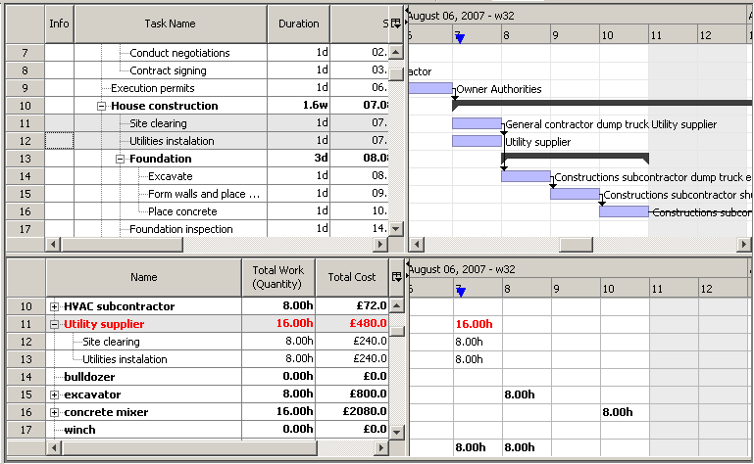
Who am I?

Slide 16
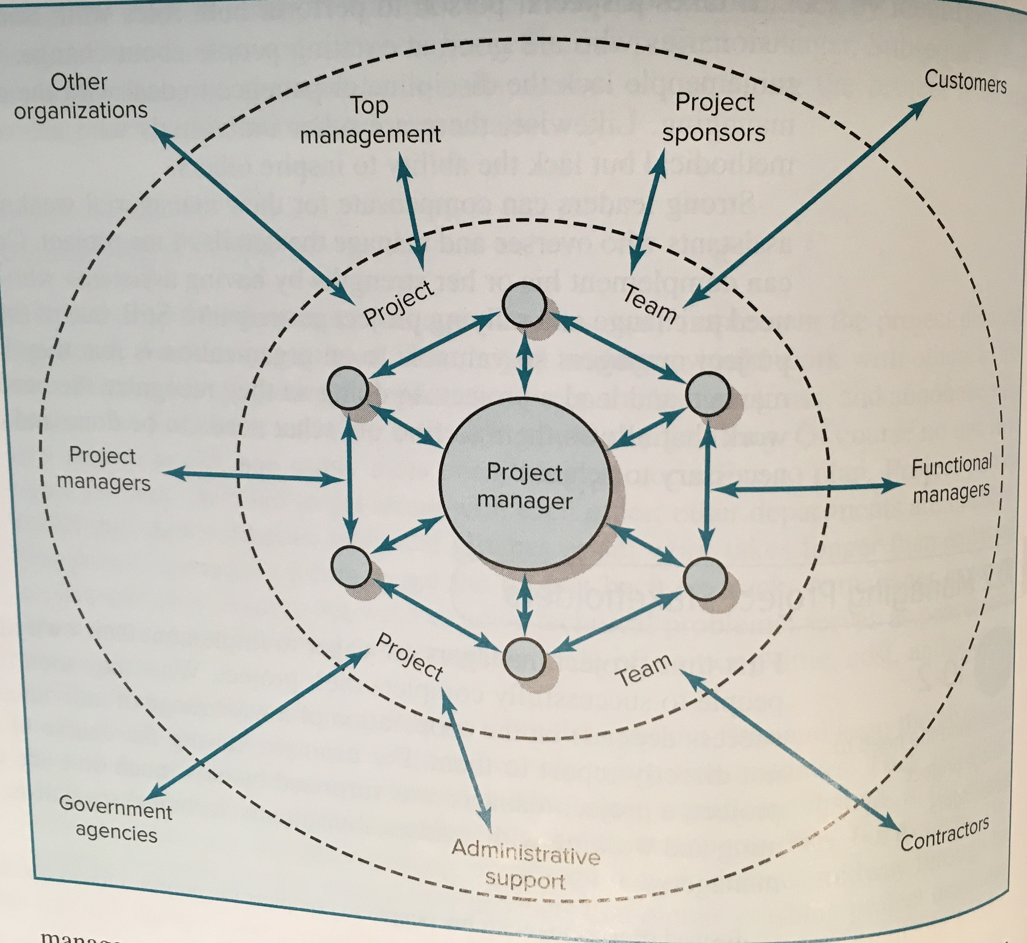
Name that knowledge area

Slide 17
Vocabulary
The Tuckman Model is a framework used to analyze and plan for which of the 10 project management knowledge areas?

Slide 18
Calculate
A project with a PV of $300, AC of $370, and EV of $330 has a CPI and SPI of what?
Notes:
CPI = 330/370 = 89.1%
SPI = 330/300 = 110%

Slide 19
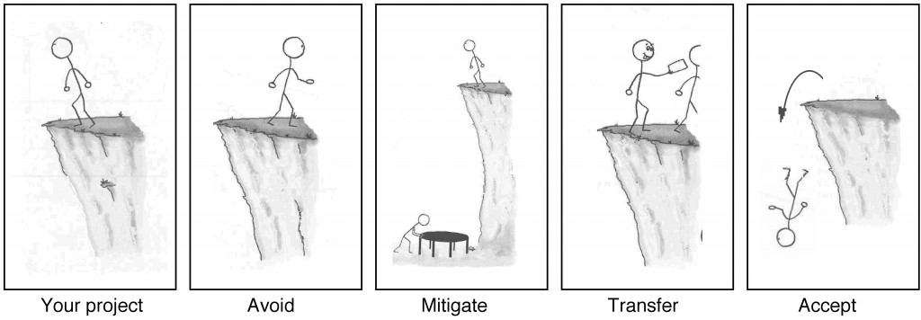
Who am I?

Slide 20
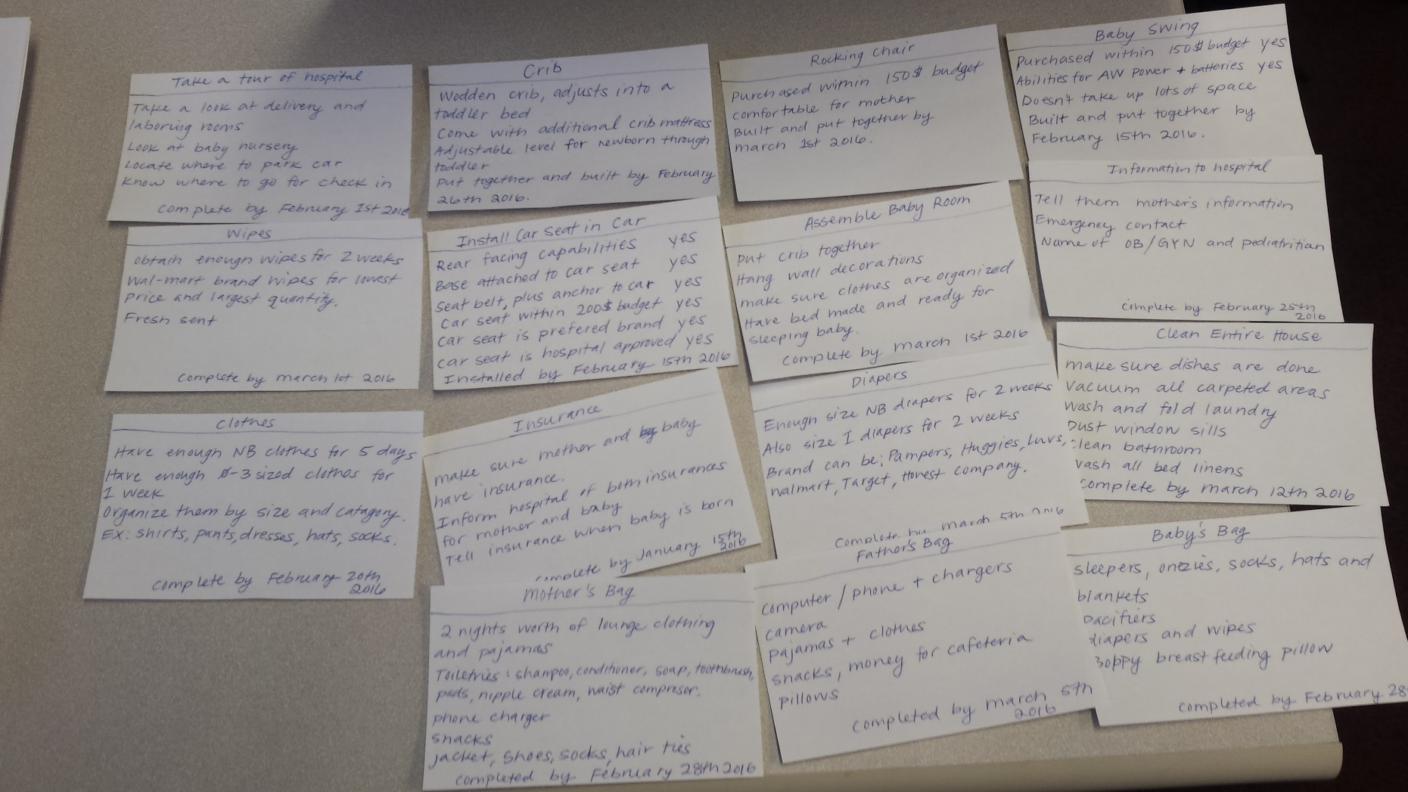
Who am I?

Slide 21
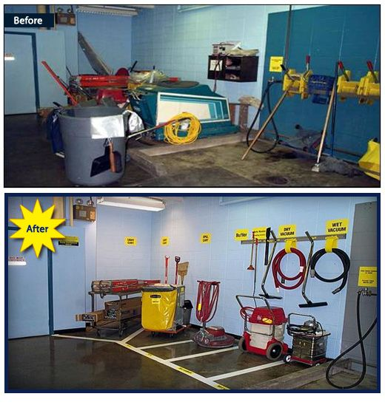
Name that method (or technique)

